Slide 1
CHAPTER 1
FUNDAMENTALS OF LOGIC DESIGN

Slide 2
NUMBER SYSTEM
https://slideplayer.com/slide/13101516/

Slide 3
1’s and 2’s Compliment
https://slideplayer.com/slide/14536678/
https://slideplayer.com/slide/13906900/

Slide 4
Combinational Circuits
Gates
https://slideplayer.com/slide/17857625/

Slide 5
Combinational Circuits
https://slideplayer.com/slide/8008915/
k map problems
https://www.gatevidyalay.com/tag/karnaugh-map-questions-and-answers-pdf/

Slide 6
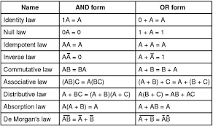

Slide 7
encoder and decoder
https://www.geeksforgeeks.org/encoders-and-decoders-in-digital-logic/

